Slide 1
Introduction to Dictionary Coding
Dr. Arup Kumar Pal
Department of Computer Science & Engineering
Indian School of Mines, Dhanbad
Jharkhand-826004
E-mail: arupkrpal@gmail.com

Slide 2
Dictionary Coding
Construct a list of commonly occurring patterns and encode these patterns by transmitting their index in the list
In general, dictionary-based techniques works well for highly correlated data (e.g. text), but less efficient for data with low correlation (e.g. i.i.d. sources)

Slide 3
Motivation behind Dictionary Coding
Consider an ‘English’ source with 26 letters & six punctuation marks
Single-symbol FLC, fixed-length encoding: 5 bps
Four-symbol FLC, fixed-length encoding: 20 bps (32⁴)
If we assume uneven distribution of the symbols
Pick a dictionary witch contains the 256 most-frequent patterns (probability p) and encode them with 8 bits
Encode the rest with 20 bits
Use 1-bit prefix to distinguish the two cases
Then, the average rate is 9p + 21(1 – p) = 21 – 12p.
If p > 0.084, 21 – 12p < 20.

Slide 4
Categorization of Dictionary-Based Coding
The heart of dictionary coding is the formulation of the dictionary.
A successfully built dictionary results in data compression; the opposite case may lead to data expansion.
According to the ways in which dictionaries are constructed, dictionary coding techniques can be classified as static or adaptive.

Slide 5
Static Dictionary Coding
A fixed dictionary,
Produced before the coding process
Used at both the transmitting and receiving ends
It is possible when the knowledge about the source alphabet and the related strings of symbols, also known as phrases, is sufficient.
Merit of the static approach: its simplicity.
Its drawbacks lie on
Relatively lower coding efficiency
Less flexibility compared with adaptive dictionary techniques

Slide 6
Static Dictionary Coding
An example of static algorithms occurs is diagram coding.
A simple and fast coding technique.
The dictionary contains:
all source symbols and
some frequently used pairs of symbols.
In encoding, two symbols are checked at once to see if they are in the dictionary.
If so, they are replaced by the index of the two symbols in the dictionary, and the next pair of symbols is encoded in the next step.

Slide 7
Static Dictionary Coding
If not, then the index of the first symbol is used to encode the first symbol. The second symbol is combined with the third symbol to form a new pair, which is encoded in the next step.
The diagram can be straightforwardly extended to n-gram. In the extension, the size of the dictionary increases and so is its coding efficiency.

Slide 8
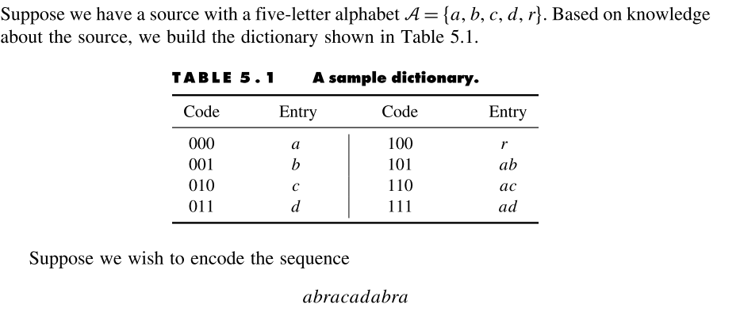
Static Dictionary Coding
101 100 110 111 101 100 000

Slide 9
Sliding Window (LZ77) Algorithms
Introduction
The dictionary used is actually a portion of the input text, which has been recently encoded.
The text that needs to be encoded is compared with the strings of symbols in the dictionary.
The longest matched string in the dictionary is characterized by a pointer (sometimes called a token), which is represented by a triple of data items.
Note that this triple functions as an index to the dictionary.
In this way, a variable-length string of symbols is mapped to a fixed-length pointer.

Slide 10
Introduction
There is a sliding window in the LZ77 algorithms. The window consists of two parts: a search buffer and a look-ahead buffer.
The search buffer contains: the portion of the text stream that has recently been encoded --- the dictionary.
The look-ahead buffer contains: the text to be encoded next.
The window slides through the input text stream from beginning to end during the entire encoding process.
The size of the search buffer is much larger than that of the look-ahead buffer.
The sliding window: usually on the order of a few thousand symbols.
The look-ahead buffer: on the order of several tens to one hundred symbols.

Slide 11
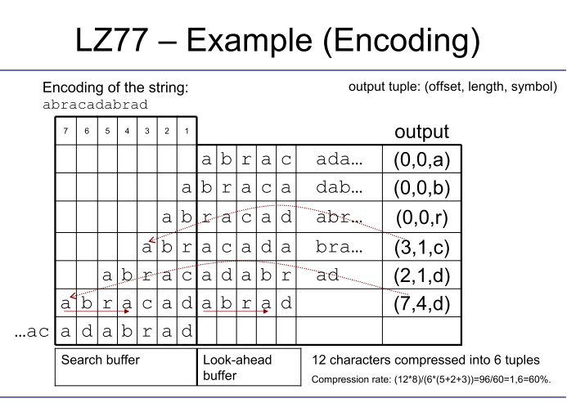

Slide 12
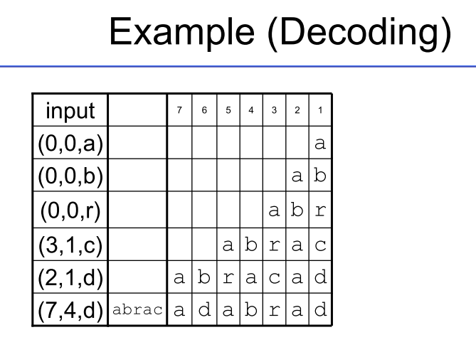

Slide 13
Summary of the LZ77 Approach
The first symbol in the look-ahead buffer is the symbol or the beginning of a string of symbols to be encoded at the moment. Let us call it the symbol s.
In encoding, the search pointer moves to the left, away from the symbol s, to find a match of the symbol s in the search buffer. When there are multiple matches, the match that produces the longest matched string is chosen. The match is denoted by a triple <i, j, k>.

Slide 14
Summary of the LZ77 Approach
The first item in the triple, “i”, is the offset, which is the distance between the pointer pointing to the symbol giving the maximum match and the symbol s.
The second item, “j”, is the length of the matched string.
The third item, “k”, is the codeword of the symbol following the matched string in the look-ahead buffer.
At the very beginning, the content of the search buffer can be arbitrarily selected. For instance, the symbols in the search buffer may all be the space symbol.

Slide 15
Summary of the LZ77 Approach
The limitation of the approach is that if the distance between the repeated patterns in the input text stream is larger than the size of the search buffer, then the approach cannot utilize the structure to compress the text.

Slide 16
LZ78 Algorithm
Limitations with LZ77:
If the distance between two repeated patterns is larger than the size of the search buffer, then the LZ77 algorithms cannot work efficiently.
It cannot recognize the patterns occurring some time ago because they may have been shifted out from the buffer. In this situation, the patterns are ignored and no matches are found.
Increasing the sizes of the search buffer and the look-ahead buffer seemingly will resolve the problems. A close look, however, reveals that it also leads to increases in the number of bits required to encode the offset and matched string length as well as an increase in processing complexity.

Slide 17
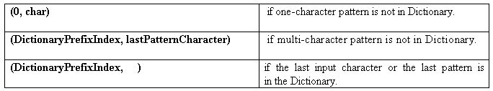
LZ78 Algorithm
LZ78 are developed to maintain a dictionary that allow patterns to remain as entries permanently during the whole encoding process.
LZ78 Output:

Slide 18
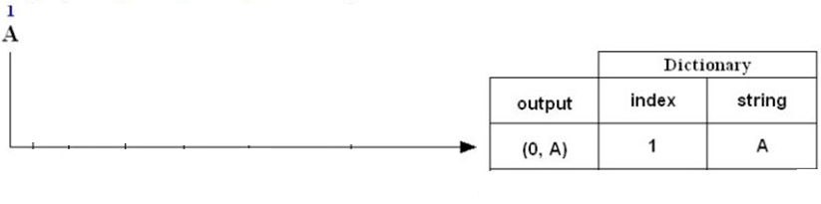
Example: LZ78 Compression
Encode (i.e., compress) the string ABBCBCABABCAABCAAB using the LZ78 algorithm.
ABBCBCABABCAABCAAB
A is not in the Dictionary; insert it

Slide 19
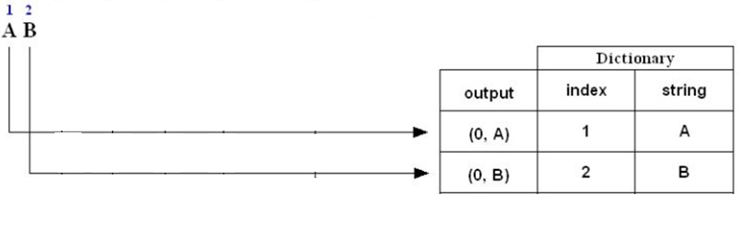
Example: LZ78 Compression
Encode (i.e., compress) the string ABBCBCABABCAABCAAB using the LZ78 algorithm.
ABBCBCABABCAABCAAB
B is not in the Dictionary; insert it

Slide 20
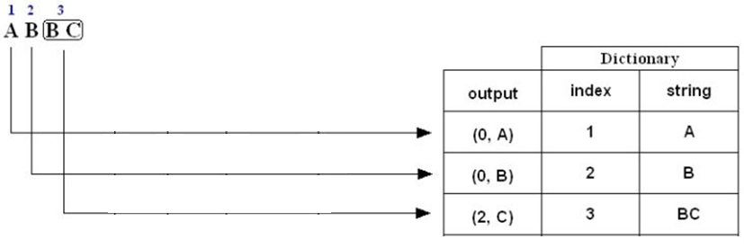
Example: LZ78 Compression
Encode (i.e., compress) the string ABBCBCABABCAABCAAB using the LZ78 algorithm.
ABBCBCABABCAABCAAB
B is in the Dictionary.
BC is not in the Dictionary; insert it.

Slide 21
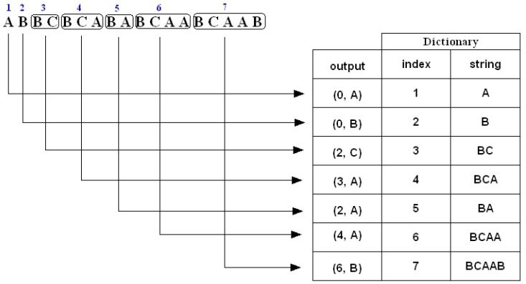
Example: LZ78 Compression
Encode (i.e., compress) the string ABBCBCABABCAABCAAB using the LZ78 algorithm.
ABBCBCABABCAABCAAB
The compressed message is: (0,A)(0,B)(2,C)(3,A)(2,A)(4,A)(6,B)
Note: The above is just a representation, the commas and parentheses are not transmitted;

Slide 22
LZ78 Compression: Number of bits transmitted
Uncompressed String: ABBCBCABABCAABCAAB
Number of bits = Total number of characters ×8
= 18 × 8
= 144 bits
Compressed string( codewords):
(0, A) (0, B) (2, C) (3, A) (2, A) (4, A) (6, B)
Each code word consists of an integer and a character:
The character is represented by 8 bits.
The integer part of the codeword is represented by 3 bits.
Total Bit=11×7=77bits

Slide 23
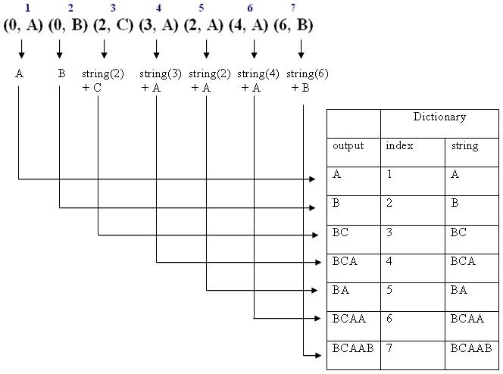
LZ78 Decompression
The decompressed message is: ABBCBCABABCAABCAAB

Slide 24
Summary of the LZ78 Approach
No use of the sliding window.
Instead of the triples used in the LZ77, only pairs are used in the LZ78.
In LZ78, only the position of the pointer to the matched string and the symbol following the matched string need to be encoded.
In theory the dictionary can keep the patterns forever after they have been seen once. In practice, the size of the dictionary cannot grow indefinitely. Some patterns may need to be reinstalled when the dictionary is full.

Slide 25
The LZW Algorithm
LZW uses fixed-length indices to represent variable-length strings of symbols/characters that commonly occur together, e.g., words in English text.
The LZW encoder and decoder build up the same dictionary dynamically while receiving the data.
LZW places longer and longer repeated entries into a dictionary, and then emits the code for an element, rather than the string itself, if the element has already been placed in the dictionary.

Slide 26
Introduction to LZW
LZW compression uses a code table, with 4096 as a common choice for the number of table entries.
Codes 0-255 in the code table are always assigned to represent single bytes from the input file.
When encoding begins the code table contains only the first 256 entries, with the remainder of the table being blanks.
Compression is achieved by using codes 256 through 4095 to represent sequences of bytes.
As the encoding continues, LZW identifies repeated sequences in the data, and adds them to the code book.

Slide 27
LZW Encoding Algorithm
Repeat not end of input stream
Step 1: Find the longest match w in the dictionary
Step 2: Output the index of w
Step 3: Put w+n in the dictionary where n was the unmatched symbol

Slide 28
Example: Compression using LZW
Use the LZW algorithm to compress the string
BABAABAAA
STRING TABLE |  | ENCODER OUTPUT
Entry | Index | representing | output code
A | 1
B | 2

Slide 29
Example 1: LZW Compression
BABAABAAA
STRING TABLE |  | ENCODER OUTPUT
Entry | Index | representing | output code
A | 1
B | 2
BA | 3 | B | 2

Slide 30
Example 1: LZW Compression
BABAABAAA
STRING TABLE |  | ENCODER OUTPUT
Entry | Index | representing | output code
A | 1
B | 2
BA | 3 | B | 2
AB | 4 | A | 1

Slide 31
Example 1: LZW Compression
BABAABAAA
STRING TABLE |  | ENCODER OUTPUT
Entry | Index | representing | output code
A | 1
B | 2
BA | 3 | B | 2
AB | 4 | A | 1
BAA | 5 | BA | 3

Slide 32
Example 1: LZW Compression
BABAABAAA
STRING TABLE |  | ENCODER OUTPUT
Entry | Index | representing | output code
A | 1
B | 2
BA | 3 | B | 2
AB | 4 | A | 1
BAA | 5 | BA | 3
ABA | 6 | AB | 4

Slide 33
Example 1: LZW Compression
BABAABAAA
STRING TABLE |  | ENCODER OUTPUT
Entry | Index | representing | output code
A | 1
B | 2
BA | 3 | B | 2
AB | 4 | A | 1
BAA | 5 | BA | 3
ABA | 6 | AB | 4
AA | 7 | A | 1

Slide 34
Example 1: LZW Compression
BABAABAAA
STRING TABLE |  | ENCODER OUTPUT
Entry | Index | representing | output code
A | 1
B | 2
BA | 3 | B | 2
AB | 4 | A | 1
BAA | 5 | BA | 3
ABA | 6 | AB | 4
AA | 7 | A | 1
 |  | AA | 7

Slide 35
LZW Decoding Algorithm
Initialize dictionary
Decode first index to w
Repeat not end of indices
{
Step 1: Decode next index to S
Step 2: Add w with first character of S to the Dictionary
Step 3: Update w by S
}

Slide 36
Example: Decoding using LZW
Use the LZW algorithm to compress the string
213417 w = B
STRING TABLE |  | DECODER OUTPUT
Entry | Index | representing | Index
A | 1
B | 2 | B | 2

Slide 37
Example: Decoding using LZW
Use the LZW algorithm to compress the string
213417 w = B S=A
STRING TABLE |  | DECODER OUTPUT
Entry | Index | representing | Index
A | 1
B | 2 | B | 2
BA | 3 | A | 1

Slide 38
Example: Decoding using LZW
Use the LZW algorithm to compress the string
213417 w = A S=BA
STRING TABLE |  | DECODER OUTPUT
Entry | Index | representing | Index
A | 1
B | 2 | B | 2
BA | 3 | A | 1
AB | 4 | BA | 3

Slide 39
Example: Decoding using LZW
Use the LZW algorithm to compress the string
213417 w = BA S=AB
STRING TABLE |  | DECODER OUTPUT
Entry | Index | representing | Index
A | 1
B | 2 | B | 2
BA | 3 | A | 1
AB | 4 | BA | 3
BAA | 5 | AB | 4

Slide 40
Example: Decoding using LZW
Use the LZW algorithm to compress the string
213417 w = AB S=A
STRING TABLE |  | DECODER OUTPUT
Entry | Index | representing | Index
A | 1
B | 2 | B | 2
BA | 3 | A | 1
AB | 4 | BA | 3
BAA | 5 | AB | 4
ABA | 6 | A | 1

Slide 41
Example: Decoding using LZW
Use the LZW algorithm to compress the string
213417 w = A S=?
STRING TABLE |  | DECODER OUTPUT
Entry | Index | representing | Index
A | 1
B | 2 | B | 2
BA | 3 | A | 1
AB | 4 | BA | 3
BAA | 5 | AB | 4
ABA | 6 | A | 1
A? | 7 |  | 7

Slide 42
Example: Decoding using LZW
Use the LZW algorithm to compress the string
213417 w = A S=A
STRING TABLE |  | DECODER OUTPUT
Entry | Index | representing | Index
A | 1
B | 2 | B | 2
BA | 3 | A | 1
AB | 4 | BA | 3
BAA | 5 | AB | 4
ABA | 6 | A | 1
A? | 7 |  | 7

Slide 43
Example: Decoding using LZW
Use the LZW algorithm to compress the string
213417 w = A S=A
STRING TABLE |  | DECODER OUTPUT
Entry | Index | representing | Index
A | 1
B | 2 | B | 2
BA | 3 | A | 1
AB | 4 | BA | 3
BAA | 5 | AB | 4
ABA | 6 | A | 1
AA | 7 | AA | 7

Slide 44
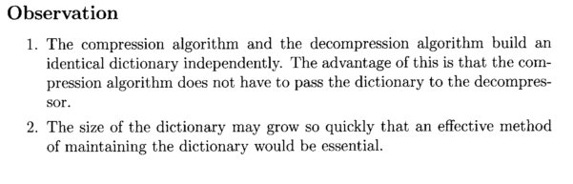
LZW Compression

